Slide 1

Managed Elasticsearch for Dispatch
Michael Alberhasky
AIS-Architecture Team
April 22, 2020
Notes:
AIS = 6 full-time; 2 students
Dispatch sent 61 million messages in 2019.

Slide 2
What is Elasticsearch?
Distributed search and analytics engine
Built upon Apache Lucene
RESTful interface
Elasticsearch + Logstash + Kibana = ELK stack
AIS also uses it for log searching and course searching in MyUI.

Slide 3
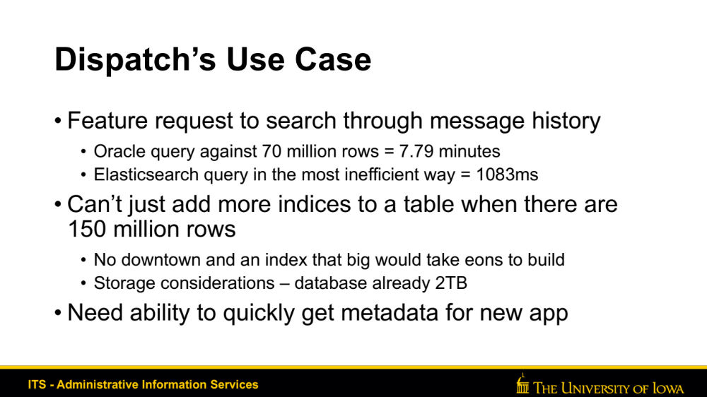
Dispatch’s Use Case
Feature request to search through message history
  Oracle query against 70 million rows = 7.79 minutes
  Elasticsearch query in the most inefficient way = 1083ms
Can’t just add more indices to a table when there are 150 million rows
  No downtown and an index that big would take eons to build
  Storage considerations – database already 2TB
Need ability to quickly get metadata for new app

Slide 4
Managed Services
Paying to use it (hopefully cheaper than it would cost to run it yourself)
Updates/patches are done for you
Backups happen automatically
Self-service tools for configuration
Basic monitoring provided

Slide 5

Hosting our own or Managed on AWS?
PRO
CON
Elasticity - If I need a cluster with more CPU for ingesting lots of data, I can change instance type easily
New feature called UltraWarm Storage - Extend your storage into low cost storage so you can search through gobs more data
Blue/Green deployments take time as the entire cluster must be replaced and data copied to new cluster. Data can still be read/write to old cluster while that is happening
More expensive then just trying to run your own - however, time is money - $335/month

Slide 6
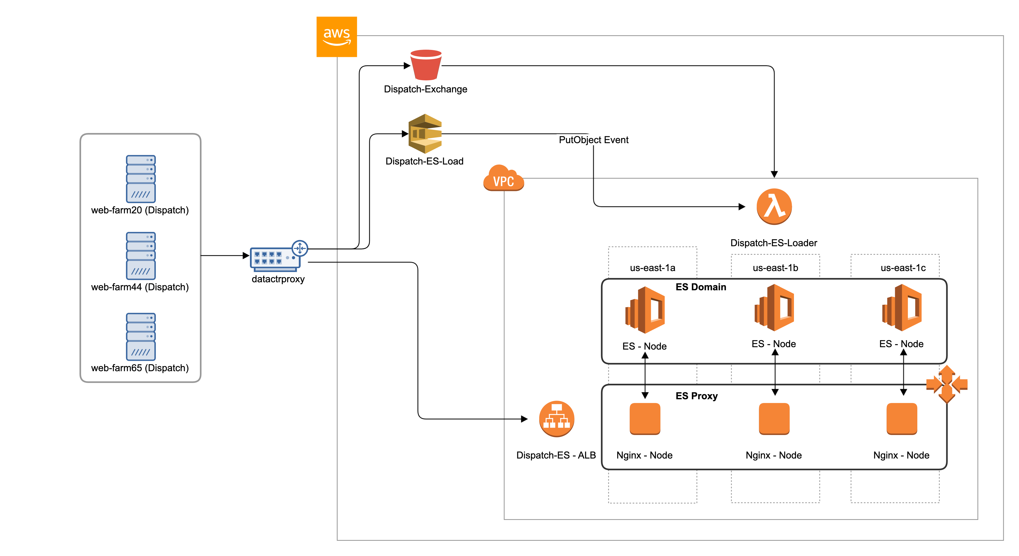
Architecture

Slide 7
Interfaces
{
"query": {
"bool": {
"filter": [{
"bool": {
"minimum_should_match": 1,
"should": [ {
"match_phrase": {
"member_id": ”foobar-1234-abcd-5678"
}
}
]
}
}],
"must": [{
"range": {
"index_date": {
"format": "strict_date_optional_time",
"gte": "2020-04-15T20:25:16.707Z",
"lte": "2020-04-15T20:55:16.707Z"
}
}
}],
"must_not": [],
"should": []
}
}
}
RESTful API offers ability query indices via:
  Query DSL
  SQL
Kibana

Slide 8





It’s a bird, it’s a plane, it’s a cache
Treat indices like a cache, it could go poof at any time.
Message metadata loaded to Elasticsearch after batch is completed.
Daily exports of metadata to S3.
Load Lambda function to rapidly reload indices.
S3 Bucket
SQS Queue
Load Function
Elasticsearch
Dispatch

Slide 9
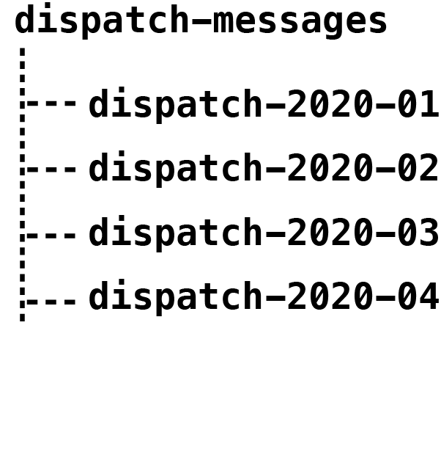
Index Design
Index for each day = bad idea
Index for each month = good idea
Aliased to a super index
Curator to manage indices and delete old indices
AWS now offers index management as a feature

Slide 10
It ain’t free
3 x m5.large.elasticsearch with 70GB each
On-demand pricing:
  Compute: $0.142/hour = $306.72
  Storage: $9.45/month x 3 = $28.35
Elected not to use dedicated Master nodes
Opportunities for reduced cost:
  Reserved instances would save over $100/month
  Reduce number of instances and accept higher risk?

Slide 11
Demo
Search function in Dispatch
Kibana interface
AWS Console

Slide 12
Michael Alberhasky
319-353-4484
michael-alberhasky@uiowa.edu

